Slide 1

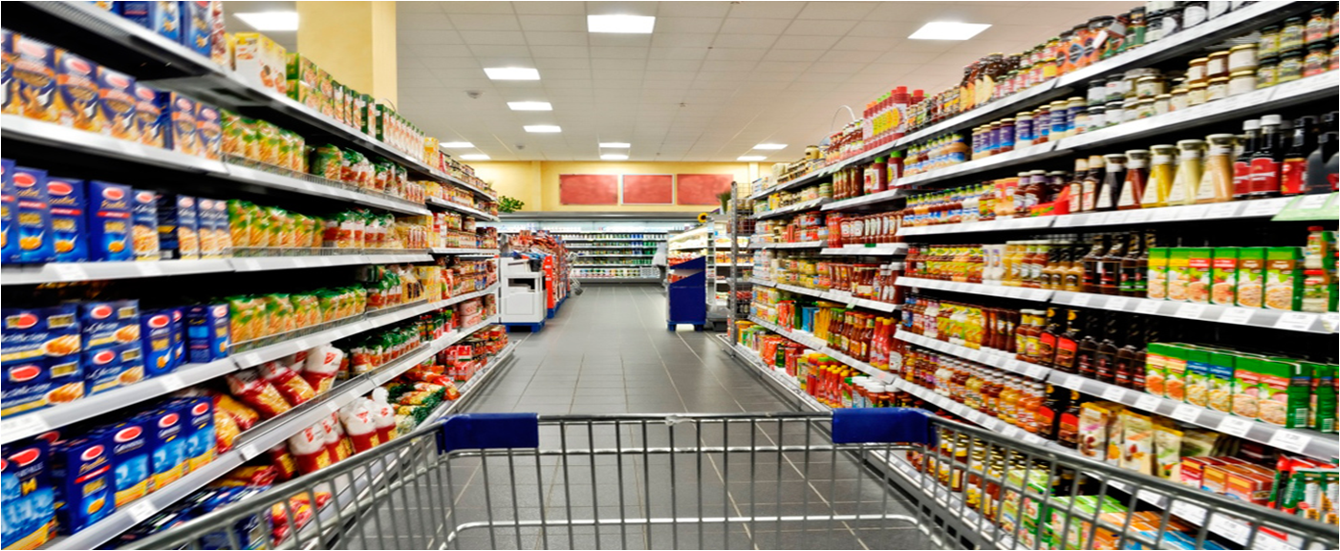


BOOSTING RETAIL REVENUE
Analyzing Macroeconomic Factors and Promotions
A Research Project by Tanusree
Notes:
Hello, This is Tanusree Mondal. I have done masters in economics from Calcutta University. Currently, I'm enrolled in a data analytics course at Ivy Professional School. As a part of this course, I am going to present a research project which is focused on the retail industry within a small UK neighborhood. This presentation aims to explore the intricacies of this case study, addressing industry challenges, conducting analysis, and proposing solutions.

Slide 2

CONTENT
Case study
Objectives
Retail Sales (2020-2022)
Important determinants of retail sales
Correlation Analysis
Regression Analysis
Holiday Vs non-holiday weeks
Store size and Sales
Store Type and Sales
Findings
Recommendations
Notes:
This page shows a glimpse of what I am going to present next. I'll begin by providing an overview of the case background, followed by an analysis of the key findings, and finally, we'll discuss the implications and recommendations.

Slide 3
CASE STUDY
This case study includes three datasets pertaining to retail store sales performance in the United Kingdom:
Features: Independent variables like promotional expenses and macroeconomic factors.
Sales: Weekly sales data for 45 UK neighborhood stores (physical stores) from 2020-2022.
Stores: Information about store size and type.
Notes:
To work on this case, I have collected secondary datasets from online sources. So, we have three datasets, namely features, sales, and stores- that captures different aspects of retail store sale performance in a UK neighborhood. Features shows the data of different independent variables like promotional expenses done by the stores, avg temperature of the week, and macroeconomic factors like consumer price index, unemployment and fuel price from 2020-2022. Sales dataset consists of weekly sales data 45 UK neighborhood stores for the same period. And lastly, the stores dataset consists of information about the type and size of these stores.

Slide 4
OBJECTIVES
Analysis of Promotional Strategies:
Evaluate the impact of macroeconomic indicators on weekly sales in retail stores.
Examine the influence of promotional strategies employed by retail stores on their sales performance.
Recommendation Focus: Provide tailored recommendations to enhance sales performance by optimizing strategies and operations in these businesses.
Notes:
This research aims to assess how macroeconomic indicators and promotional strategies employed by retail stores impact their weekly sales. Subsequently, I intend to offer recommendations to these businesses on enhancing their sales performance through optimization.

Slide 5
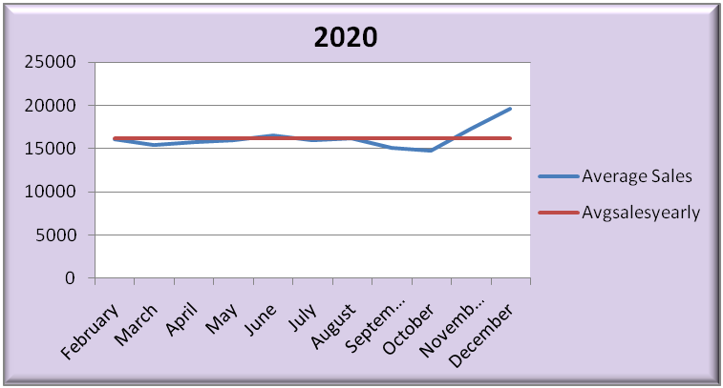
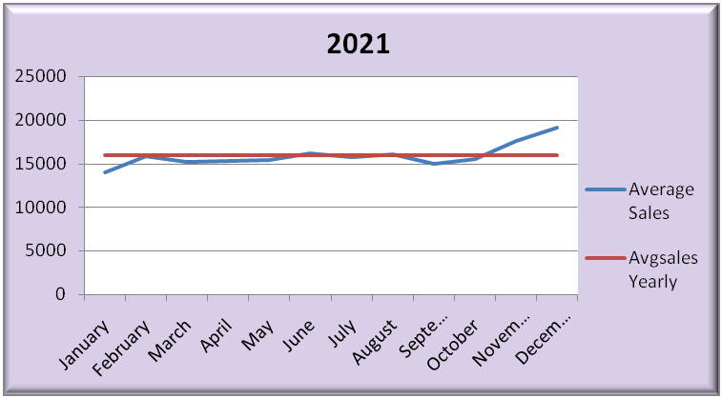
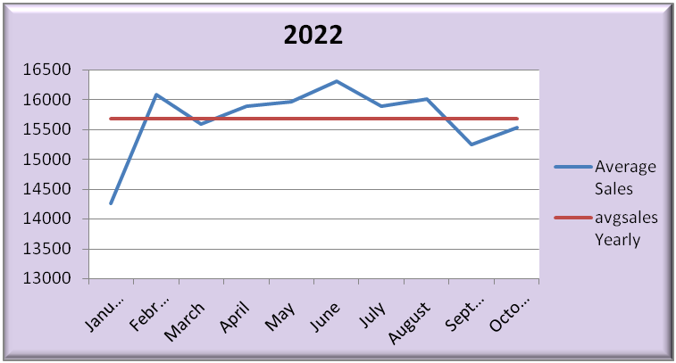
RETAIL SALES(2021-2021)
Yearly Sales Volatility: Sales data for 2020 and 2021 showed relatively lower volatility compared to 2022.
Seasonal Sales Trends: Sales generally exhibited an upward trend from March to April and a decline during September to October, with a subsequent increase towards the end of each year.
Notes:
For this, first I have done some trend analysis to understand the Weekly Sales of 45 UK stores from 2020 to 2022 has been depicted through the line charts. This charts indicate a lower volatility in weekly sales for the years 2020 and 2021 compared to 2022. A typical pattern of sales can be observed from these charts. The weekly sales typically rose from March to April and declined in September to October, followed by a year-end increase.

Slide 6
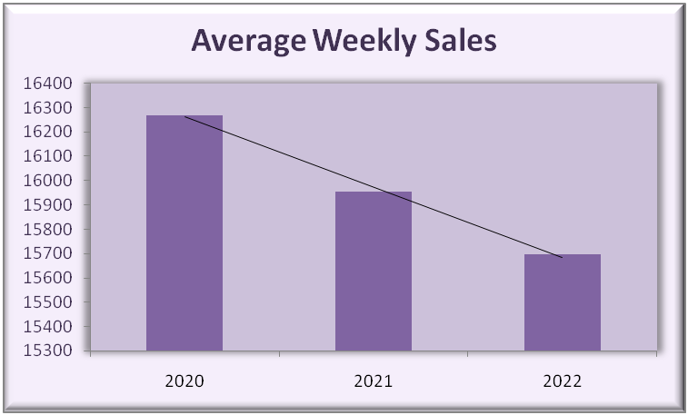
RETAIL SALES(2021-2021)
The Average sales of these stores are declining over three years.
There's been significant sales volatility during 2020-2022.
Over 50% of these stores are consistently performing below average in terms of sales.
Notes:
Over the past three years, average sales have declined. The weekly sales data shows a substantial standard deviation. This indicates that these stores have experienced notable fluctuations in sales during this period. Also it has been noted that more than 50% of these stores are consistently underperforming.

Slide 7
IMPORTANT DETERMINANTS OF RETAIL SALES
Macroeconomic indicators:
Consumers Price Index or CPI
Unemployment rate
Fuel Price
Average Temperature of week
Holiday(s) in a week
Promotional factors like advertisements, free gifts or discounts.
Notes:
To address the business problem, we need to comprehend the independent factors that can influence the sales of a physical store. Some of these factors, which have been addressed in this case study, include the average weekly temperature, holidays, promotional activities implemented by store owners, and the macroeconomic conditions of the country, such as fuel prices, the unemployment rate, and the consumer price index.

Slide 8
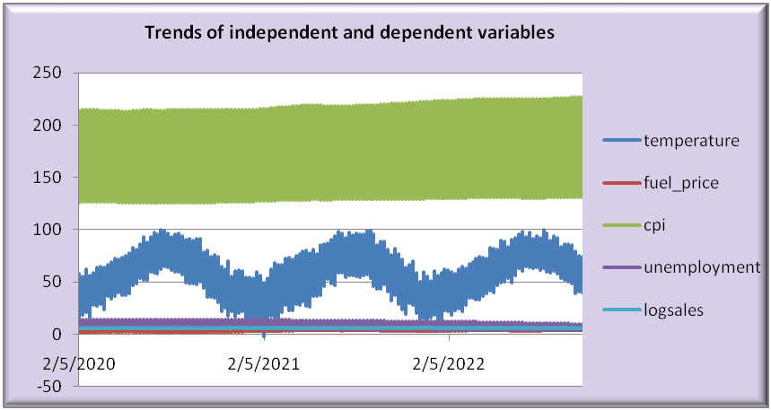
CORRELATION ANALYSIS: MACROECONOMIC INDICATORS
A correlation analysis was conducted to ascertain the association between macroeconomic indicators such and temperature with store sales performance.
The results indicate that these independent variables do not exert a significant influence on sales variability.
Notes:
I carried out a correlation analysis to see how average temperature of the week and the macroeconomic indicators like the CPI, unemployment rate, fuel prices relate to store sales performance. The findings suggest that these independent variables don't have a major impact on the variations in sales

Slide 9
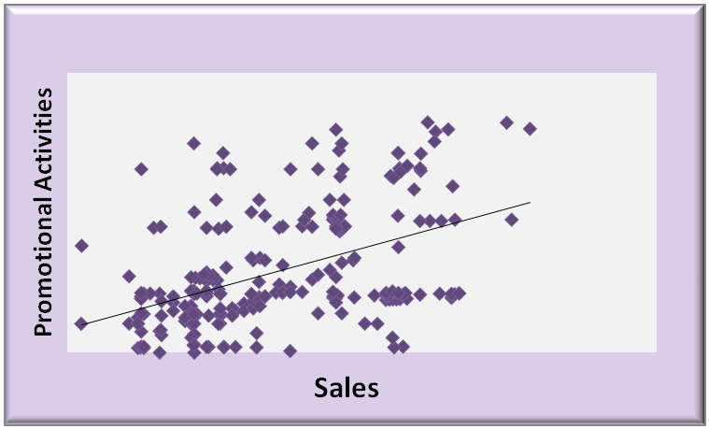
REGRESSION ANALYSIS: PROMOTIONAL ACTIVITIES
A regression analysis was undertaken to assess the impact of promotional activities on the sales performance of the retail stores.
The findings revealed a statistically significant and positive effect of promotional activities on sales performance.
Nevertheless, it's important to note that promotional activities explain only a limited portion of the overall sales variability.
Notes:
A regression analysis was conducted to understand how promotional activities affect the sales performance of these retail stores. The results showed a statistically significant and positive impact of these activities on sales performance. However, it's worth noting that promotional activities account for only a small part of the total variation in sales.

Slide 10
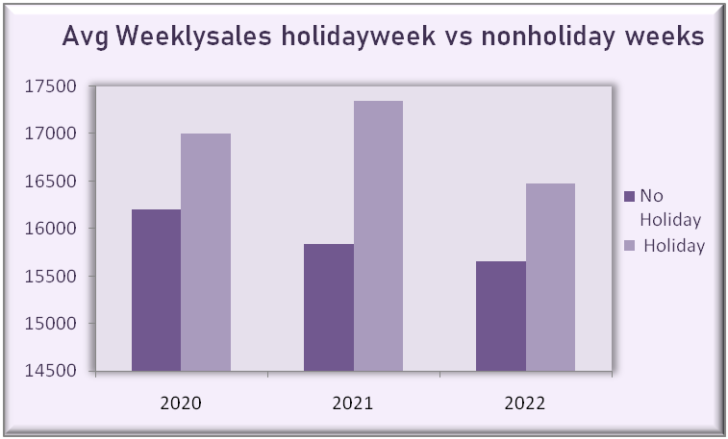
HOLIDAY VS NON-HOLIDAY WEEKS
These stores demonstrate stronger sales performance during weeks that include holidays compared to weeks without any holiday.
Notes:
This bar chart categorizes the average weekly sales in these stores, distinguishing between weeks with holidays and weeks without holidays over a three-year period. It's evident that these stores generate higher sales revenue during weeks with holidays compared to those without any holiday.

Slide 11
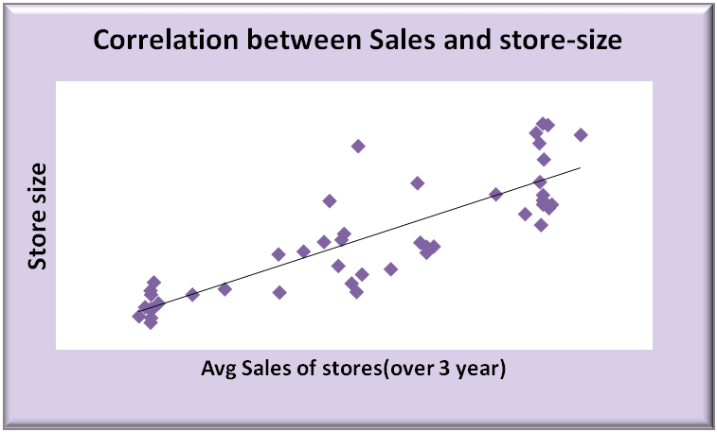
STORE SIZE AND SALES
There exists a strong correlation between store size and weekly sales.
This suggests that larger store facilities tend to attract more customers, ultimately leading to improved sales performance within these establishments.
Notes:
The correlation analysis shows a strong correlation between the size of a store and its weekly sales. The same is also evident from this scatter plot. This implies that larger stores have a tendency to draw in more customers, which, in turn, results in better sales performance for them.

Slide 12
FINDINGS
Sales typically rose from March to April, dipped in September to October, and then rebounded towards year-end.
Over 50% of stores consistently perform below average.
The macroeconomic conditions of the country do not exert a significant impact on the sales performance.
Both promotional activities and holiday periods exhibit a positive influence on retail sales.
Store size is found to have a positive effect on retail sales, indicating that larger store facilities tend to drive higher sales figures.
Notes:
Now that we've explored the case in detail and analyzed the various factors at play, let's move on to the key findings and recommendations. From our analysis we find that sales, in these stores, usually went up from March to April, took a dip in September to October, and picked up again towards the end of the year. More than half of these stores consistently perform below the average. The overall economic conditions in the country don't seem to have a major impact on sales. Promotional activities and holiday seasons both boost retail sales. Weeks with both holidays and promotions consistently have the best average sales. Bigger store spaces lead to higher sales.

Slide 13
RECOMMENDATIONS
Implementation of discount schemes, combo offers, and free gift vouchers for customers during holiday weeks.
Promotional activities should be strategically scheduled for the months of January-February and September-October.
Stores with consistent underperformance require investigation and strategic intervention. If they consistently have high customer traffic, consider expanding their size.
Notes:
The foremost recommendation is to implement discount schemes, combo offers, and free gift vouchers for customers during holiday weeks. Promotional activities should be strategically scheduled for the months of January-February and September-October. The stores displaying consistent underperformance warrant thorough investigation and strategic intervention by their respective leadership teams to identify the root causes. If these stores consistently experience high customer traffic, it is advisable to consider expanding their physical footprint.

Slide 14




Thank You
Notes:
Thank you for giving me this opportunity to present this case study.

